Slide 1
-Networking
-Socket Programming
Topic 0
Fundamentals

Slide 2
Outline of the Talk
Basic Concepts
Socket Programming in C
Socket Programming in Java
Socket Programming in Perl
Conclusion

Slide 3
Computer Network
A computer network is an interconnected collection of autonomous computers.

Slide 4
What a Network Includes
A network includes:
  Special purpose hardware devices that:
    Interconnect transmission media
    Control transmission of data
    Run protocol software
  Protocol software that:
    Encodes and formats data
    Detects and corrects problems encountered during transmission

Slide 5
Addressing and Routing
Address: byte-string that identifies a node
  usually unique
Routing: process of forwarding messages to the destination node based on its address
Types of addresses
  unicast: node-specific
  broadcast: all nodes on the network
  multicast: some subset of nodes on the network

Slide 6
Network Architecture
A network architecture is a set of layers and protocols used to reduce network design complexity.
The TCP/IP Protocol Suite (also called the Internet Architecture) is an important example of a network architecture.
The OSI (Open Systems Interconnection) 7-Layer Reference Model [ISO,1984] is a guide that specifies what each layer should do, but not how each layer is implemented.

Slide 7
ISO 7-Layer Reference Model
End host
End host
Application
Application
Various applications (FTP,HTTP,…)
Presentation
Presentation
Present data in a meaningful format
Session
Session
Provide session semantics (RPC)
Transport
Transport
Reliable, end-to-end byte stream (TCP)
Network
Network
Network
Network
Unreliable end-to-end tx of packets
Data link
Data link
Data link
Data link
Reliable transmission (tx) of frames
Physical
Physical
Physical
Physical
Unreliable transmission (tx) of raw bits
One or more nodes
within the network

Slide 8
Layering
Use abstractions to hide complexity
Abstraction naturally leads to layering
Alternative abstractions exist at each layer
Application programs
Request/reply
Message stream
channel
channel
Host-to-host connectivity
Hardware

Slide 9
Protocols
A protocol is a set of rules of communication. Protocols are the building blocks of a network architecture.
Each protocol object has two different interfaces:
  service interface: operations on this protocol
  peer-to-peer interface: messages exchanged with peer
Term “protocol” is overloaded
  specification of peer-to-peer interface
  module that implements this interface

Slide 10
Interfaces
Host 1
Host 2
High-level
Service
High-level
object
interface
object
Protocol
Peer-to-peer
Protocol
interface

Slide 11
Network Programming
A network allows arbitrary applications to communicate.
However, a network programmer doesn’t need to know the details of all lower-level network technologies.
Network facilities are accessed through an Application Programming Interface (API); e.g., a Service Interface.

Slide 12
Internet Architecture
Defined by Internet Engineering Task Force (IETF)
Hourglass Design
Application vs Application Protocol (FTP, HTTP)
FTP
HTTP
NV
TFTP
TCP
UDP
IP
NET
…
NET
1
2
NET
n

Slide 13
Basic Paradigm for
Communication
Most network applications can be divided into two pieces: a client and a server.
A Web browser (a client) communicate with a Web server.
A Telnet client that we use to log in to a remote host.
A user who needs access to data located at remote server.

Slide 14
Basic Paradigm for
Communication
Establish contact (connection).
Exchange information (bi-directional).
Terminate contact.

Slide 15
Client-Server Paradigm
Server waits for client to request a connection.
Client contacts server to establish a connection.
Client sends request.
Server sends reply.
Client and/or server terminate connection.

Slide 16
Two types of Communication
Connection-oriented
  Setup the link before communication.
  Similar to the phone call. We need the phone number and receiver.
Connectionless
  No link needed to be set up before communication.
  Similar to send a letter. We need the address and receiver.

Slide 17
Sockets
A socket is defined as an endpoint for communication.
Concatenation of IP address and port
  Connection-oriented: Phone number and receiver
  Connectionless: Address and receiver
A socket pair (local IP address, local port, foreign IP address, foreign port) uniquely identifies a communication.
The socket 161.25.19.8:1625 refers to port 1625 on host 161.25.19.8

Slide 18


Slide 19
Sockets and Ports
any port
agreed port
socket
socket
message
client
server
other ports
Internet address = 138.37.94.248
Internet address = 138.37.88.249

Slide 20
TCP and UDP
TCP (Transmission Control Protocol) is a connection-oriented protocol.
UDP (User Datagram Protocol) is connectionless (UDP) protocol.

Slide 21
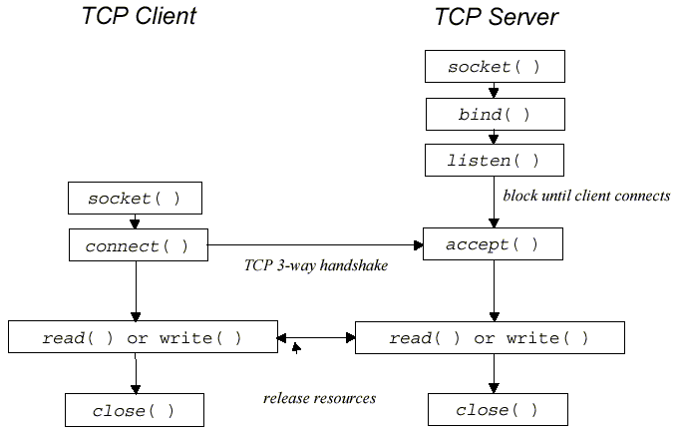
TCP Protocol

Slide 22
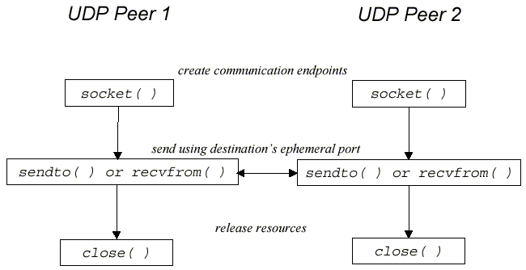
UDP Protocol

Slide 23
UNIX TCP Communication
Normally, a server would first listen and accept a connection and then fork a new process to communicate with the client.
The server or listening process first uses the socket operation to create a stream socket and the bind operation to bind its socket to the server’s socket address.
It uses the listen operation to listen for connections on a socket.
  int listen (int sockfd, int backlog) : The backlog parameter defines the maximum length the queue of pending connections may grow to.

Slide 24
UNIX TCP Communication
The server uses the accept system call to accept connection requested by a client.
After a connection has been established, both processes may then use the write (send) and read (recv) operations to send and receive messages.

Slide 25
Example - Programming Client
Initialization:
  gethostbyname - look up server
  socket - create socket
  connect - connect to server port
Transmission:
  send – send message to server
  recv - receive message from server
Termination:
  close - close socket

Slide 26
Example - Programming Server
Initialization:
  socket - create socket
  bind – bind socket to the local address
  listen - associate socket with incoming requests
Loop:
  accept - accept incoming connection
  recv - receive message from client
  send - send message to client
Termination:
  close - close connection socket

Slide 27
UNIX Datagram Communication
bind – specify the local endpoint address for a socket.
  int bind(int sockfd, struct sockaddr *my_addr,
  socklen_t addrlen);
  sockfd – a socket descriptor created by the socket call.
  my_addr – The address structure specifies an IP address and protocol port number.
  addrlen – The size of the address structure in bytes.
send, sendto, sendmsg - send a message from a socket.

Slide 28
UNIX Datagram Communication
recv, recvfrom, recvmsg - receive a message from a socket
close - close a file descriptor
UDP is not able to transfer a message more than 8KB.

Slide 29
Java API for TCP Streams
The Java API provides TCP streams by means of two classes:
  ServerSocket - This class implements server sockets. A server socket waits for requests to come in over the network.
  Socket - This class implements client sockets.
ServerSocket:
  accept - Listens for a connection to be made to this socket and accepts it. The result of executing accept is an instance of Socket.

Slide 30
Java API for TCP Streams
Socket:
  Socket (InetAddress address, int port) - Creates a stream socket and connects it to the specified port number at the specified IP address. It will throws UnknownHostException or an IOException.
  getInputStream - Returns an input stream for this socket.
  getOutputStream - Returns an output stream for this socket.
Figure 4.5 shows a client program. Figure 4.6 shows the corresponding server program.

Slide 31
Java API for UDP Datagrams
The Java API provides datagram communication by means of two classes:
  DatagramPacket - Datagram packets are used to implement a connectionless packet delivery service.
  DatagramSocket - A datagram socket is the sending or receiving point for a packet delivery service.
DatagramPacket:
  getData - Returns the data buffer.
  getPort - Returns the port number on the remote host.
  getAddress - Returns the IP address.

Slide 32
Java API for UDP Datagrams
DatagramSocket:
  send - Sends a datagram packet from this socket.
  receive - Receives a datagram packet from this socket.
  setSoTimeout - Enable/disable the specified timeout, in milliseconds.
  connect - Connects the socket to a remote address for this socket.

Slide 33
TCP Client in Perl
Call socket() to create a socket.
Call connect() to connect to the peer.
Perform I/O on the socket.
Close the socket.

Slide 34
TCP Server in Perl
Call socket() to create a socket.
Call bind() to bind to a local address.
Call listen() to mark the socket as listening.
Call accept() to accept incoming connections.
Perform I/O on the connected socket.
Close the socket.

